Slide 1



Correlations, t-test, chi-squared test, and ANOVA
Mohammed Quazi
Lead AIML | Expert Systems Inc. | https://expertsystems.inc
Statistician | Dept of Psychiatry & Behavioral Sciences UNM
Adjunct Faculty | Dept of Mathematics & Statistics UNM
Overview
Correlations
T-test for means
Chi-squared test for independence
ANOVA (F-test)
Resources
Github: https://github.com/mquazi

Slide 2

Correlations – Measure linear association
Terminologies:
Dependent variable (DV): Variable(s) which is/are predicted or is the outcome, measured/recorded in the end aka response variable
Factors: Variable(s) which impact the response variable aka independent/predictor/explanatory variables (IV)
Scatterplot: A plot which shows data points for two variables (IV and DV) in pairs
A scatterplot shows the relationship between two quantitative variables measured on the same subjects. The values of one variable appear on the horizontal axis, and the values of the other variable appear on the vertical axis.
Y (DV)
X (IV)

Slide 3
Correlations – Measure linear association
HOW TO EXAMINE A SCATTERPLOT
As in any graph of data, look for the overall pattern and for striking deviations from that pattern.
You can describe the overall pattern of a scatterplot by the direction, form, and strength of the relationship.
An important kind of departure is an outlier, an individual value that falls outside the overall pattern of the relationship.
DIRECTION OF ASSOCIATION
POSITIVE ASSOCIATION, NEGATIVE ASSOCIATION
Two variables are positively associated when above-average values of one tend to accompany above-average values of the other, and below-average values also tend to occur together.
Two variables are negatively associated when above-average values of one tend to accompany below-average values of the other, and vice versa.

Slide 4
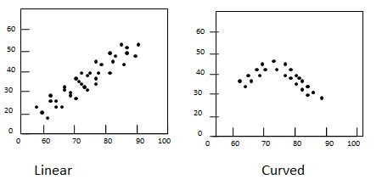
Correlations – Measure linear association
A scatterplot displays the strength, direction, and form of the relationship between two quantitative variables.
The correlation, r, measures the strength of the linear relationship between two quantitative variables.
FACTS ABOUT CORRELATION
Correlation makes NO distinction between IV and DV.
r has no units and does not change when we change the units of measurement of x, y, or both.
Positive r indicates positive association between the variables, and negative r indicates negative association.
The correlation r is always a number between –1 and 1.
Correlation requires that both variables be quantitative.
Correlation does not describe curved relationships between variables, no matter how strong the relationship is.
Correlation is not resistant. r is strongly affected by a few outlying observations.
Correlation is NOT a complete summary of two-variable data.

Slide 5


Correlations – Measure linear association
Worksheets (2)
Y (DV)
-1 0 1
X (IV)

Slide 6
2. T-test for means -- Compare means
Which statistical tests to use?
Depends on the variable of interest and the metric (relationship, mean, median etc.) of interest
Examples
t-test and z-test to compare means for two groups (or one group)
Chi-squared test to assess relationships
F-test to study ratios or compare means of three or more groups…

Slide 7
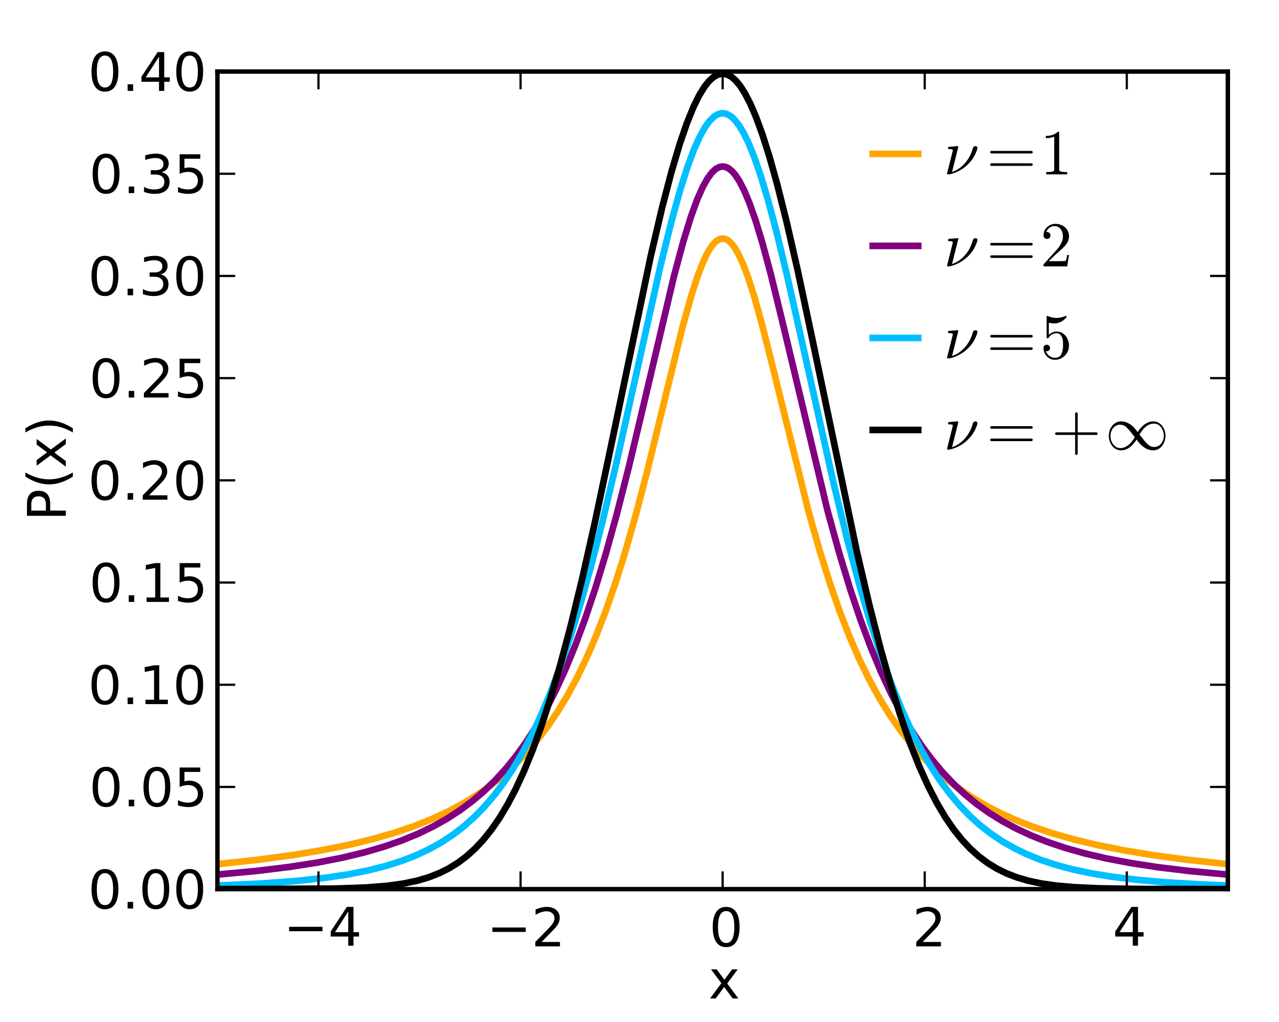
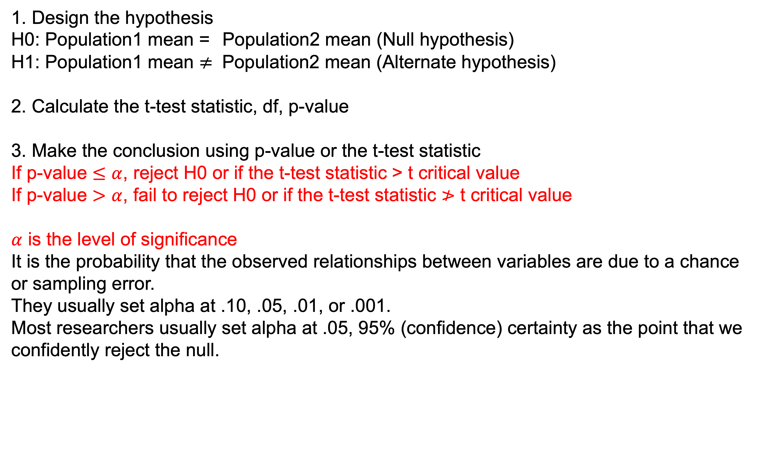
2. T-test for means -- Compare means
3 steps of a t-test
1. Design the hypothesis
H0: Population1 mean = Population2 mean (Null hypothesis)
H1: Population1 mean $≠$ Population2 mean (Alternate hypothesis)
2. Calculate the t-test statistic, df, p-value
3. Make the conclusion using p-value or the t-test statistic
If p-value $≤α$, reject H0 or if the t-test statistic > t critical value
If p-value $>α$, fail to reject H0 or if the t-test statistic $≯$ t critical value
$α$ is the level of significance
It is the probability that the observed relationships between variables are due to a chance or sampling error.
They usually set alpha at .10, .05, .01, or .001.
Most researchers usually set alpha at .05, 95% (confidence) certainty as the point that we confidently reject the null.

Slide 8
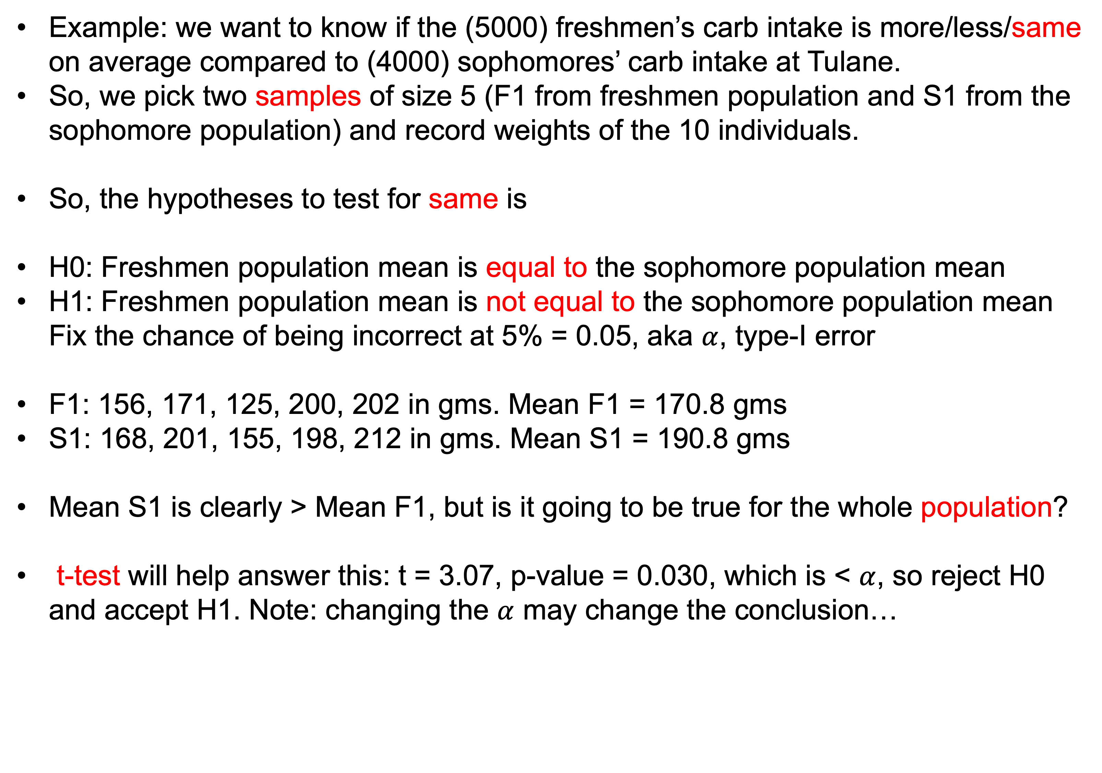
2. T-test for means -- Compare means
Example: we want to know if the (5000) freshmen’s carb intake is more/less/same on average compared to (4000) sophomores’ carb intake at Tulane.
So, we pick two samples of size 5 (F1 from freshmen population and S1 from the sophomore population) and record weights of the 10 individuals.
So, the hypotheses to test for same is
H0: Freshmen population mean is equal to the sophomore population mean
H1: Freshmen population mean is not equal to the sophomore population mean Fix the chance of being incorrect at 5% = 0.05, aka $α$, type-I error
F1: 156, 171, 125, 200, 202 in gms. Mean F1 = 170.8 gms
S1: 168, 201, 155, 198, 212 in gms. Mean S1 = 190.8 gms
Mean S1 is clearly > Mean F1, but is it going to be true for the whole population?
t-test will help answer this: t = 3.07, p-value = 0.030, which is < $α$, so reject H0 and accept H1. Note: changing the $α$ may change the conclusion…
Population
Sample

Slide 9
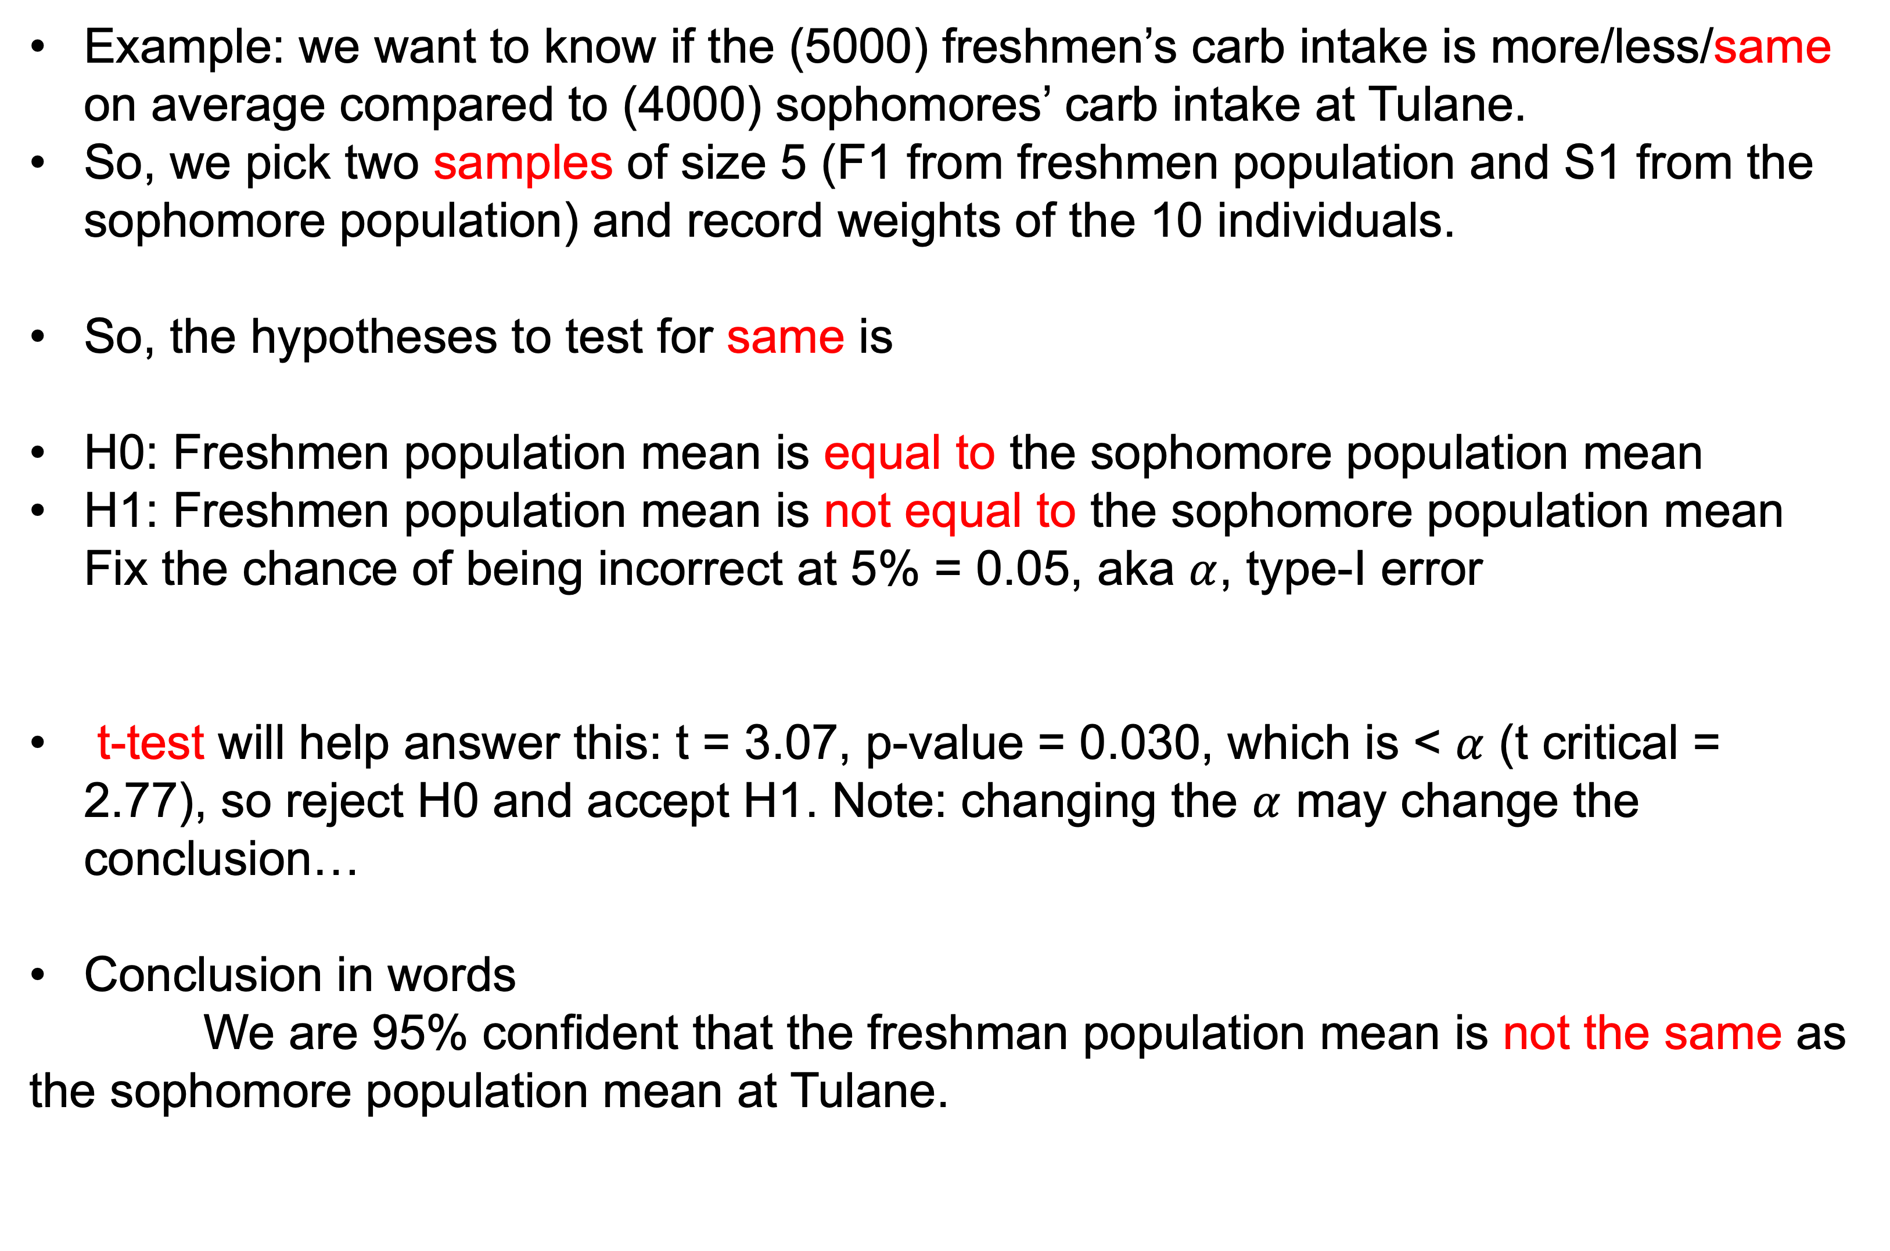
2. T-test for means -- Compare means (contd.)
Example: we want to know if the (5000) freshmen’s carb intake is more/less/same on average compared to (4000) sophomores’ carb intake at Tulane.
So, we pick two samples of size 5 (F1 from freshmen population and S1 from the sophomore population) and record weights of the 10 individuals.
So, the hypotheses to test for same is
H0: Freshmen population mean is equal to the sophomore population mean
H1: Freshmen population mean is not equal to the sophomore population mean Fix the chance of being incorrect at 5% = 0.05, aka $α$, type-I error
t-test will help answer this: t = 3.07, p-value = 0.030, which is < $α$ (t critical = 2.77), so reject H0 and accept H1. Note: changing the $α$ may change the conclusion…
Conclusion in words
We are 95% confident that the freshman population mean is not the same as the sophomore population mean at Tulane.
Population
Sample

Slide 10
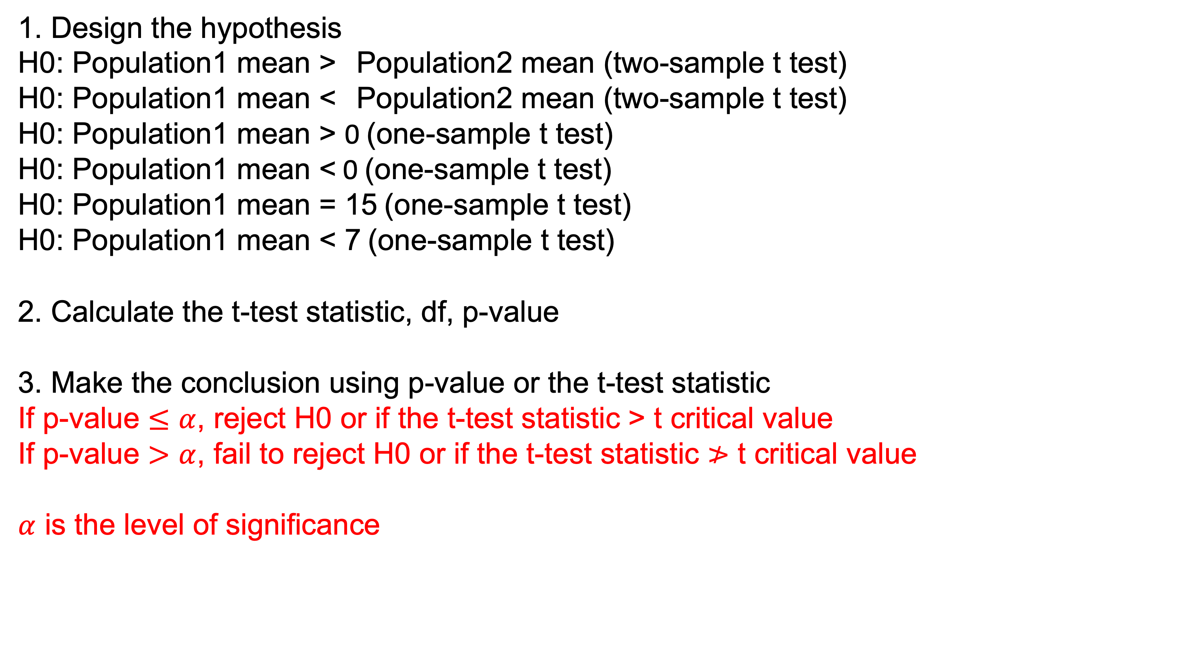
2. T-test for means -- Compare means
Variations of a t-test
1. Design the hypothesis
H0: Population1 mean > Population2 mean (two-sample t test)
H0: Population1 mean < Population2 mean (two-sample t test)
H0: Population1 mean > 0 (one-sample t test)
H0: Population1 mean < 0 (one-sample t test)
H0: Population1 mean = 15 (one-sample t test)
H0: Population1 mean < 7 (one-sample t test)
2. Calculate the t-test statistic, df, p-value
3. Make the conclusion using p-value or the t-test statistic
If p-value $≤α$, reject H0 or if the t-test statistic > t critical value
If p-value $>α$, fail to reject H0 or if the t-test statistic $≯$ t critical value
$α$ is the level of significance

Slide 11
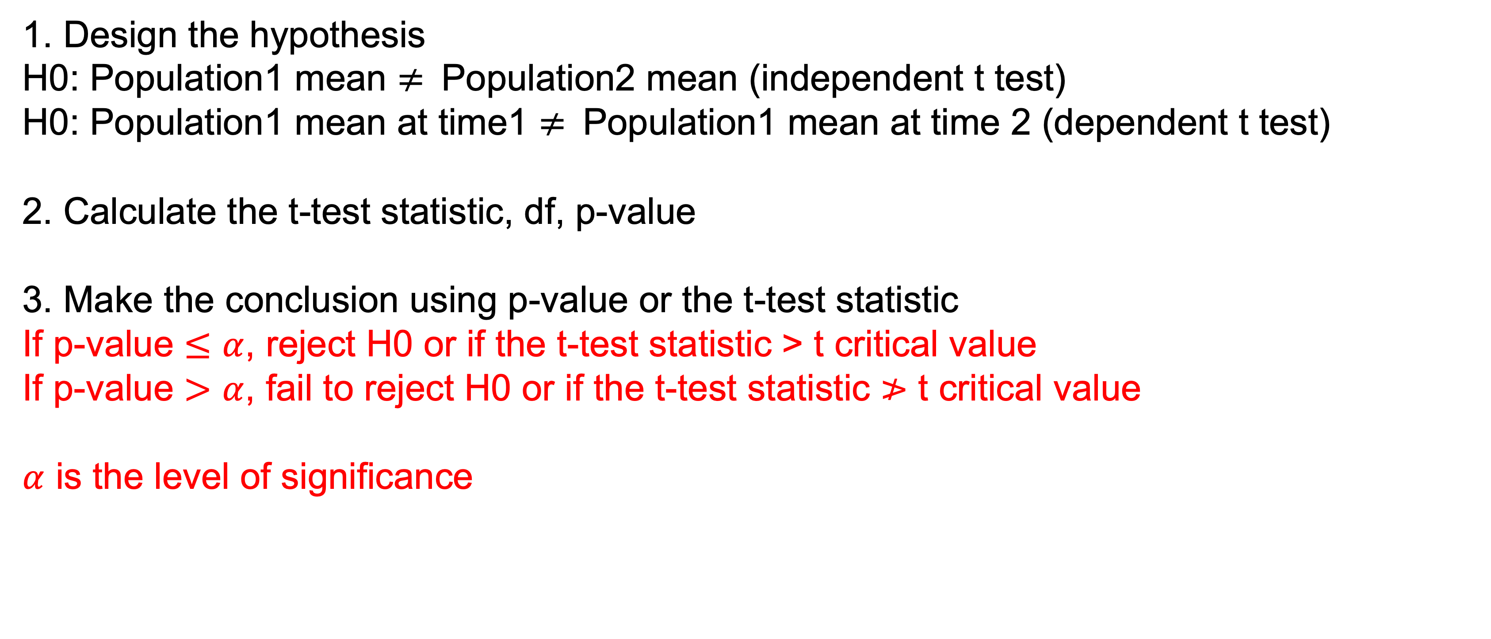
2. T-test for means -- Compare means
Variations of a t-test
1. Design the hypothesis
H0: Population1 mean $≠$ Population2 mean (independent t test)
H0: Population1 mean at time1 $≠$ Population1 mean at time 2 (dependent t test)
2. Calculate the t-test statistic, df, p-value
3. Make the conclusion using p-value or the t-test statistic
If p-value $≤α$, reject H0 or if the t-test statistic > t critical value
If p-value $>α$, fail to reject H0 or if the t-test statistic $≯$ t critical value
$α$ is the level of significance

Slide 12
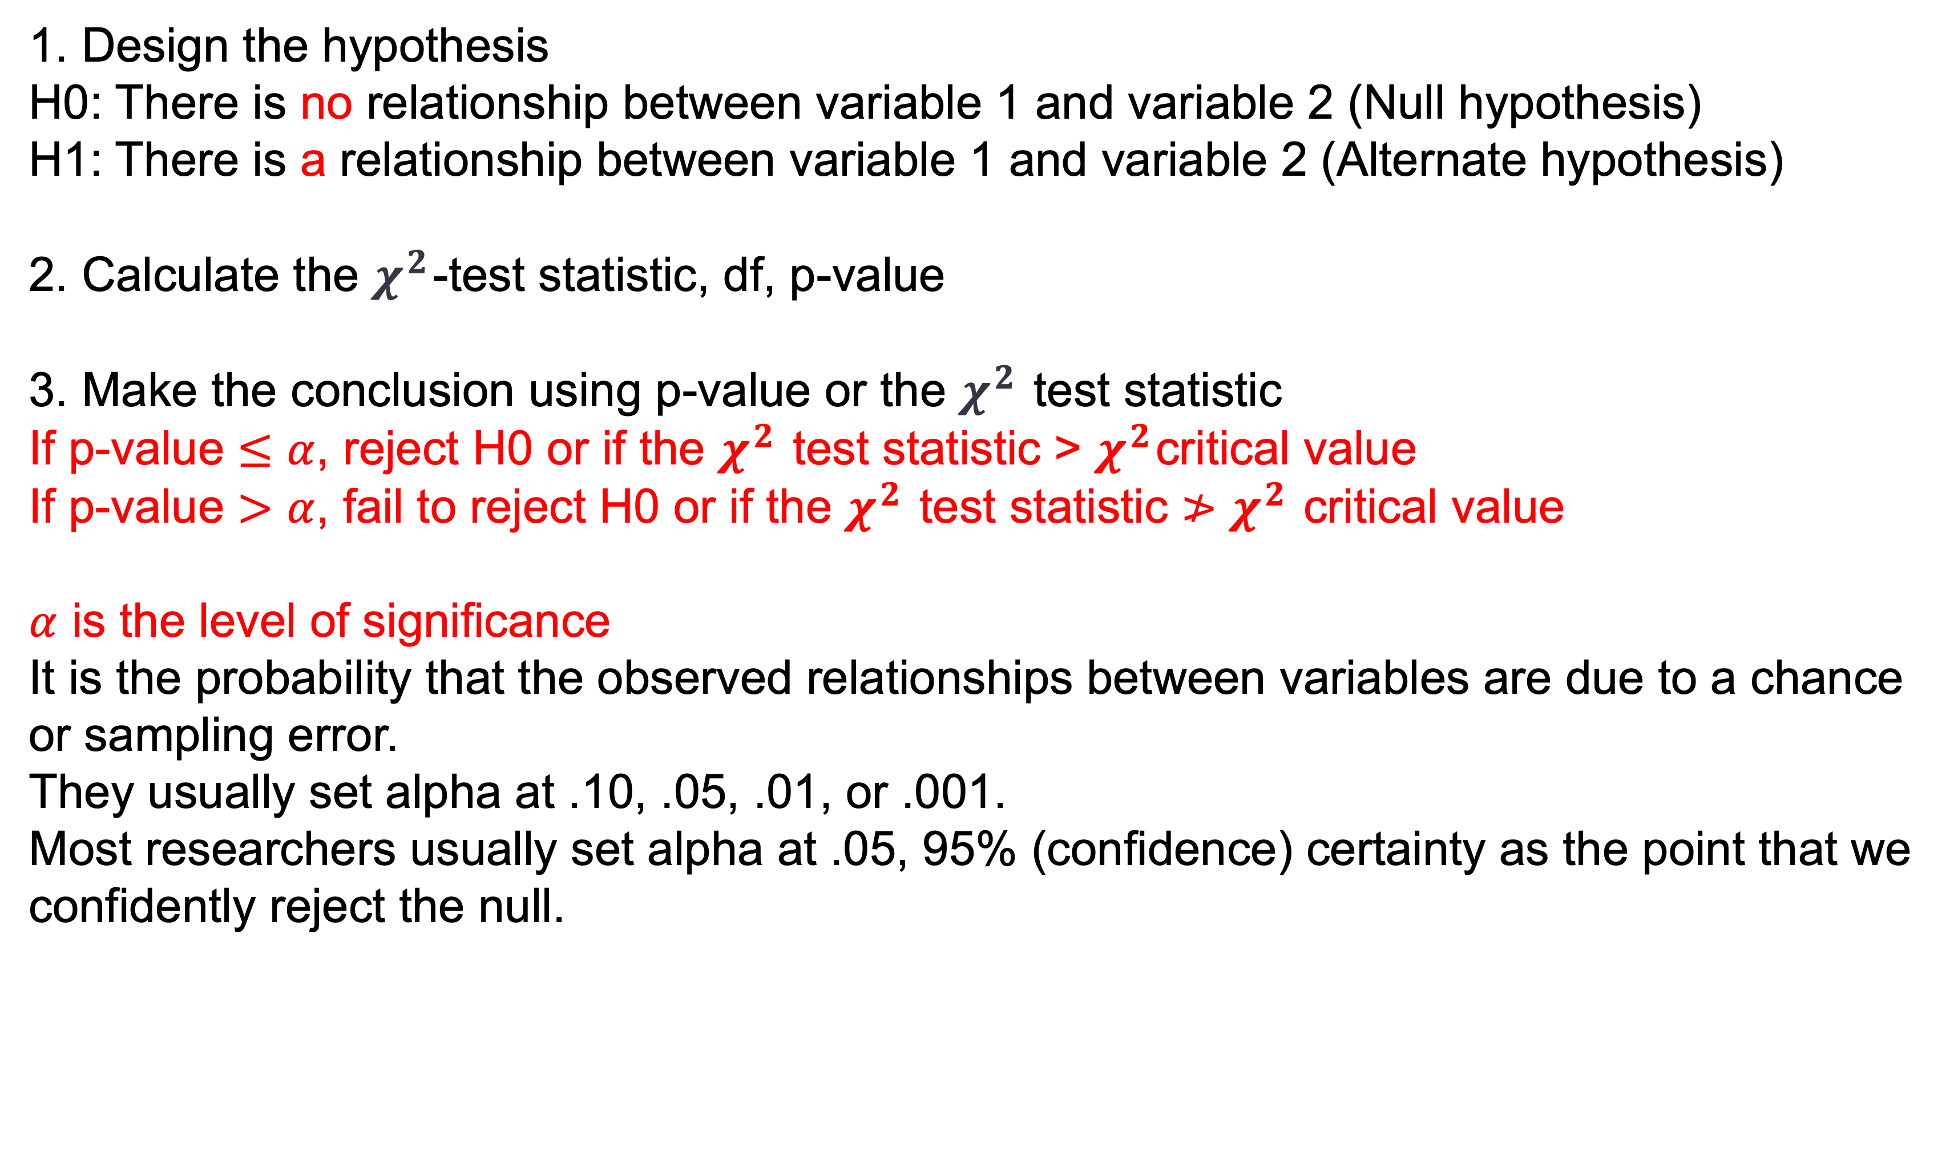
3. Chi-squared test for independence -- Compare counts
3 steps of a Chi-squared ($χ^{2}$) test (categorical variables only)
1. Design the hypothesis
H0: There is no relationship between variable 1 and variable 2 (Null hypothesis)
H1: There is a relationship between variable 1 and variable 2 (Alternate hypothesis)
2. Calculate the $χ^{2}$-test statistic, df, p-value
3. Make the conclusion using p-value or the $χ^{2}$test statistic
If p-value $≤α$, reject H0 or if the $χ^{2}$test statistic > $χ^{2}$critical value
If p-value $>α$, fail to reject H0 or if the $χ^{2}$test statistic $≯$ $χ^{2}$ critical value
$α$ is the level of significance
It is the probability that the observed relationships between variables are due to a chance or sampling error.
They usually set alpha at .10, .05, .01, or .001.
Most researchers usually set alpha at .05, 95% (confidence) certainty as the point that we confidently reject the null.

Slide 13
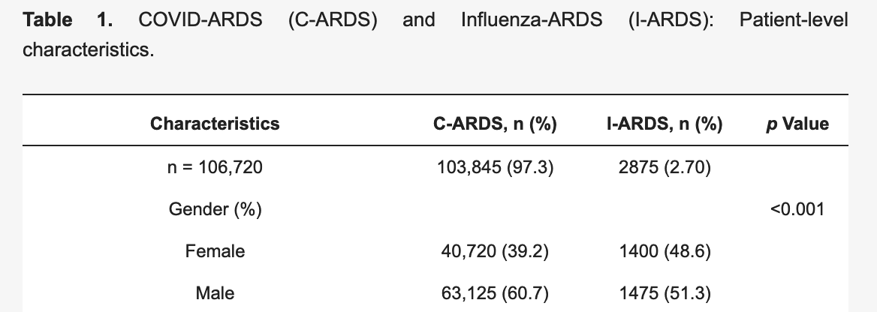
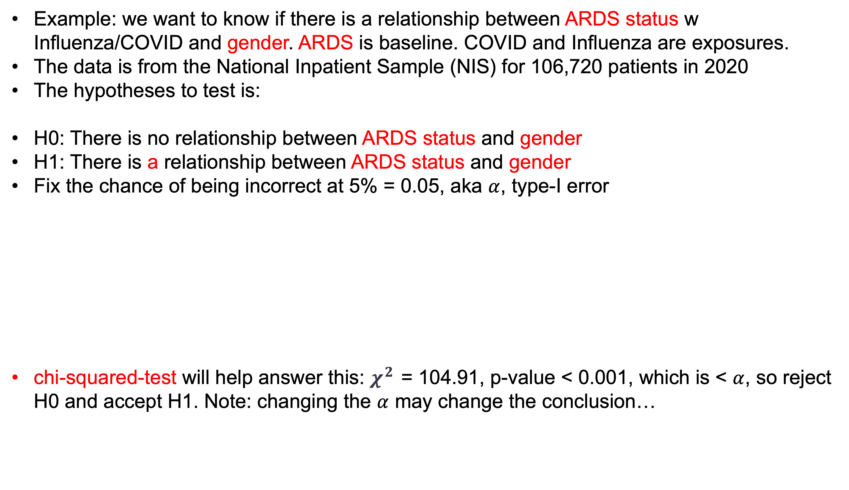
3. Chi-squared test for independence -- Compare counts
Example: we want to know if there is a relationship between ARDS status w Influenza/COVID and gender. ARDS is baseline. COVID and Influenza are exposures.
The data is from the National Inpatient Sample (NIS) for 106,720 patients in 2020
The hypotheses to test is:
H0: There is no relationship between ARDS status and gender
H1: There is a relationship between ARDS status and gender
Fix the chance of being incorrect at 5% = 0.05, aka $α$, type-I error
chi-squared-test will help answer this: $χ^{2}$= 104.91, p-value < 0.001, which is < $α$, so reject H0 and accept H1. Note: changing the $α$ may change the conclusion…
Virk, S.; Quazi, M.; et al. Comparing Clinical Outcomes of COVID-19 and Influenza-Induced Acute Respiratory Distress Syndrome: A Propensity-Matched Analysis. Viruses 2023

Slide 14
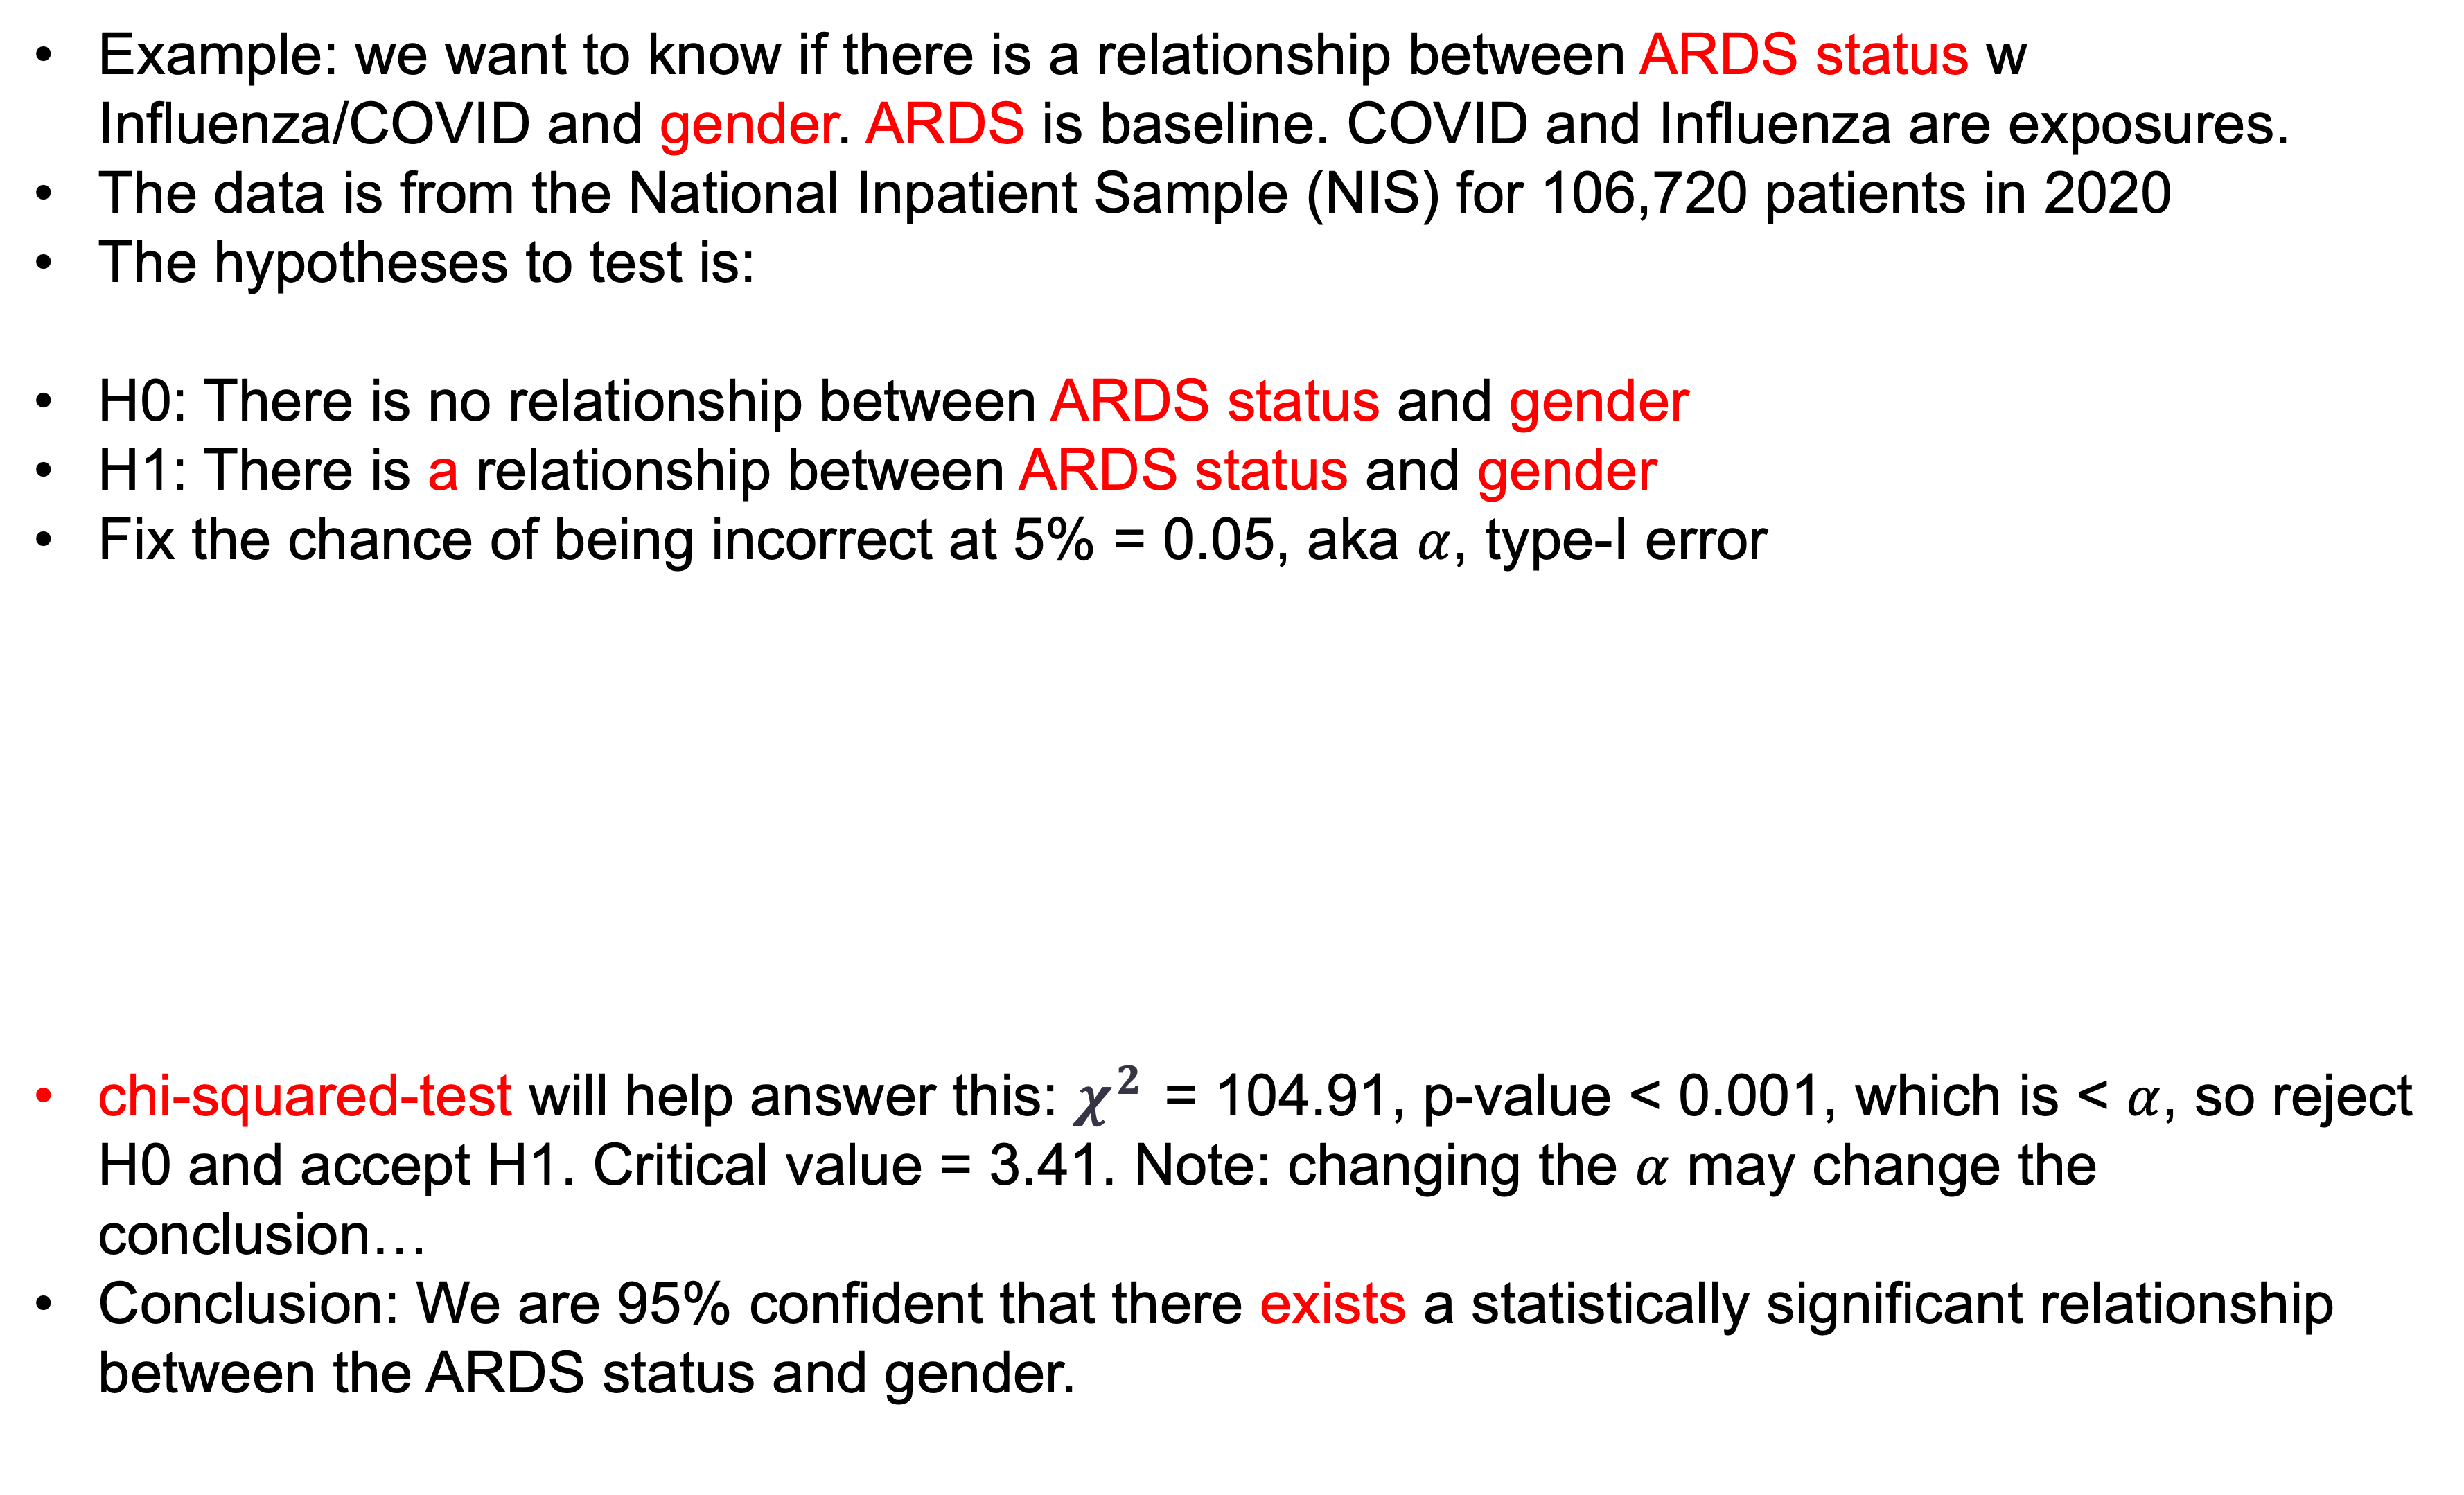
3. Chi-squared test for independence -- Compare counts (contd.)
Example: we want to know if there is a relationship between ARDS status w Influenza/COVID and gender. ARDS is baseline. COVID and Influenza are exposures.
The data is from the National Inpatient Sample (NIS) for 106,720 patients in 2020
The hypotheses to test is:
H0: There is no relationship between ARDS status and gender
H1: There is a relationship between ARDS status and gender
Fix the chance of being incorrect at 5% = 0.05, aka $α$, type-I error
chi-squared-test will help answer this: $χ^{2}$= 104.91, p-value < 0.001, which is < $α$, so reject H0 and accept H1. Critical value = 3.41. Note: changing the $α$ may change the conclusion…
Conclusion: We are 95% confident that there exists a statistically significant relationship between the ARDS status and gender.

Slide 15
4. F-test for means -- Compare means of three or more
F-test or ANOVA – Analysis of Variance
In hypothesis testing, we are often interested in more than two groups
t-tests are limited to testing for differences in one or between two groups
An analysis of variance (ANOVA), also called the F test, is a statistical procedure used to test hypotheses for one or more factors (groups or categories) concerning the variance among two or more group means, where the variance in one or more populations is unknown

Slide 16
4. F-test for means -- Compare means of three or more
F-test or ANOVA – Analysis of Variance
One-way between-subjects ANOVA, aka simple ANOVA
Similar to the independent t test, it is used when there is a nominal-level IV and an interval/ratio-level DV
Unlike the independent t test, it is not limited to a dichotomous IV (only 2 value categories)
Simple ANOVA is used when there are 3 or more value categories

Slide 17
4. F-test for means -- Compare means of three or more
Sources of Variation and the F-Test Statistic
Source of variation – any variation that can be measured in a study. In the one-way between-subjects ANOVA, there are two sources of variation
Between groups variation: variance of group means
Within groups (error) variation: variation attributed to error

Slide 18
4. F-test for means -- Compare means of three or more
Sources of Variation and the F-Test Statistic
The distribution of possible outcomes for the test statistic is positively skewed
The distribution, called the F distribution, is derived from a sampling distribution of F ratios

Slide 19
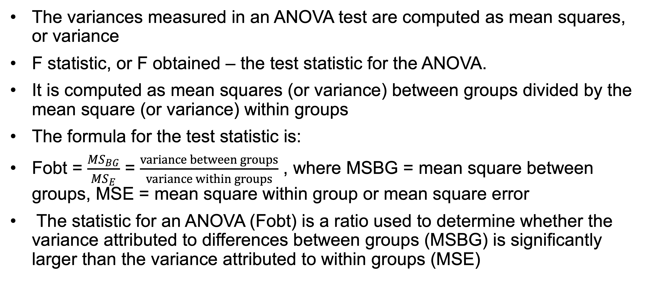
4. F-test for means -- Compare means of three or more
Sources of Variation and the F-Test Statistic
The variances measured in an ANOVA test are computed as mean squares, or variance
F statistic, or F obtained – the test statistic for the ANOVA.
It is computed as mean squares (or variance) between groups divided by the mean square (or variance) within groups
The formula for the test statistic is:
Fobt = $\frac{{MS}_{BG}}{{MS}_{E}}$ = $\frac{variance between groups}{variance within groups}$ , where MSBG = mean square between groups, MSE = mean square within group or mean square error
The statistic for an ANOVA (Fobt) is a ratio used to determine whether the variance attributed to differences between groups (MSBG) is significantly larger than the variance attributed to within groups (MSE)

Slide 20
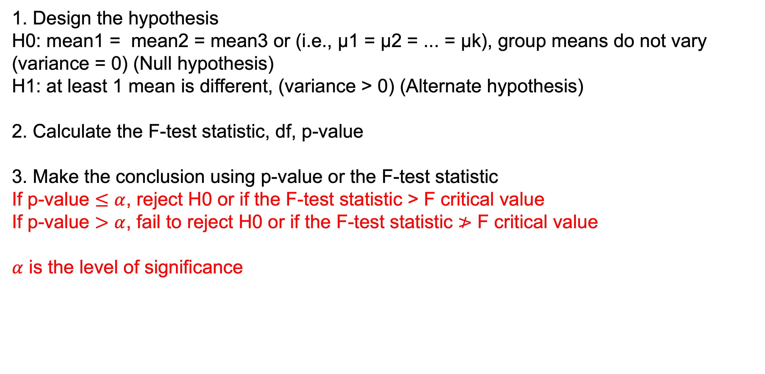
4. F-test for means -- Compare means of three or more
3 steps of an F-test
1. Design the hypothesis
H0: mean1 = mean2 = mean3 or (i.e., μ1 = μ2 = ... = μk), group means do not vary (variance = 0) (Null hypothesis)
H1: at least 1 mean is different, (variance > 0) (Alternate hypothesis)
2. Calculate the F-test statistic, df, p-value
3. Make the conclusion using p-value or the F-test statistic
If p-value $≤α$, reject H0 or if the F-test statistic > F critical value
If p-value $>α$, fail to reject H0 or if the F-test statistic $≯$ F critical value
$α$ is the level of significance

Slide 21
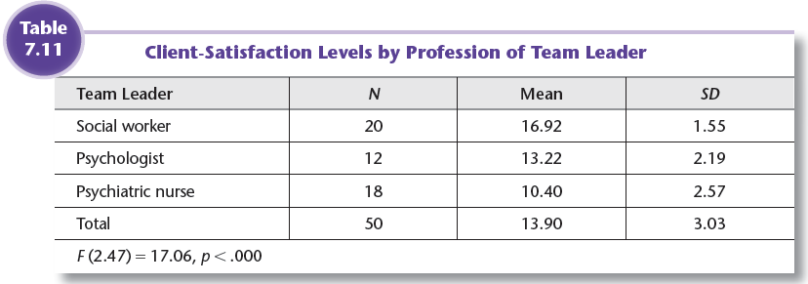
Example: Simple ANOVA
4. F-test for means -- Compare means of three or more
Client satisfaction is the DV
Must be measured in a way that generates interval/ratio data
Team leader is the IV (3 value categories)
Social worker
Psychologist
Psychiatric Nurse

Slide 22
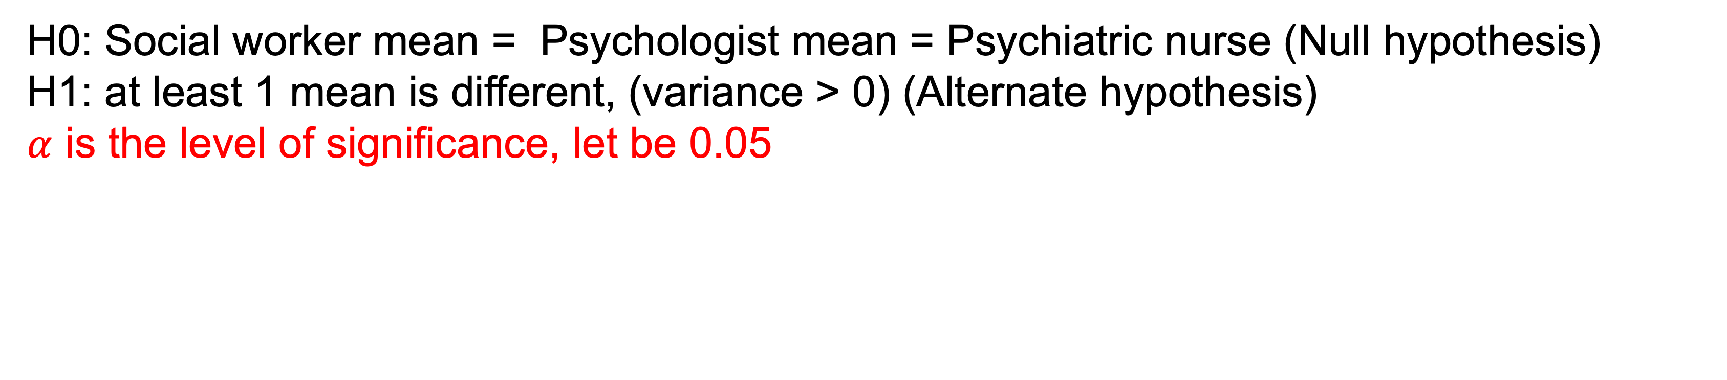
4. F-test for means -- Compare means of three or more
Example: Simple ANOVA
H0: Social worker mean = Psychologist mean = Psychiatric nurse (Null hypothesis)
H1: at least 1 mean is different, (variance > 0) (Alternate hypothesis)
$α$ is the level of significance, let be 0.05
F (2, 47)= 17.06, p-value <0.0001
F critical value: 2.44
Since p-value < 0.05, or F obtained > F critical value, we reject H0
Conclusion: We are 95% confident that there are differences on client-satisfaction between groups (social workers, psychologist, and psychiatric nurse)

Slide 23
Summary
Correlation measures linear association; it goes from -1 to +1
T-tests work for comparison of two means (or one)
Chi squared-tests are used to compare counts for categories
F-tests work for three or more means (also for two)
Look for p-values and test statistics to make a conclusion
Conclusion is either reject H0 or fail to reject H0

Slide 24
5. Resources – Materials for reference
Books:
The Basic Practice of Statistics (7th Edition), by Moore, Notz, and Fligner
Probability and Statistics for Engineering and the Sciences by Devore
Online/Datasets/code:
Github for code repositories
UC Irvine repository for datasets
Kaggle for code and datasets
Khan academy for minor statistical concepts
maquazi@salud.unm.edu

Slide 25
Thank you
maquazi@salud.unm.edu

